Slide 1

Predicting Heart Diseases: A Lifesaving Insight

Slide 2
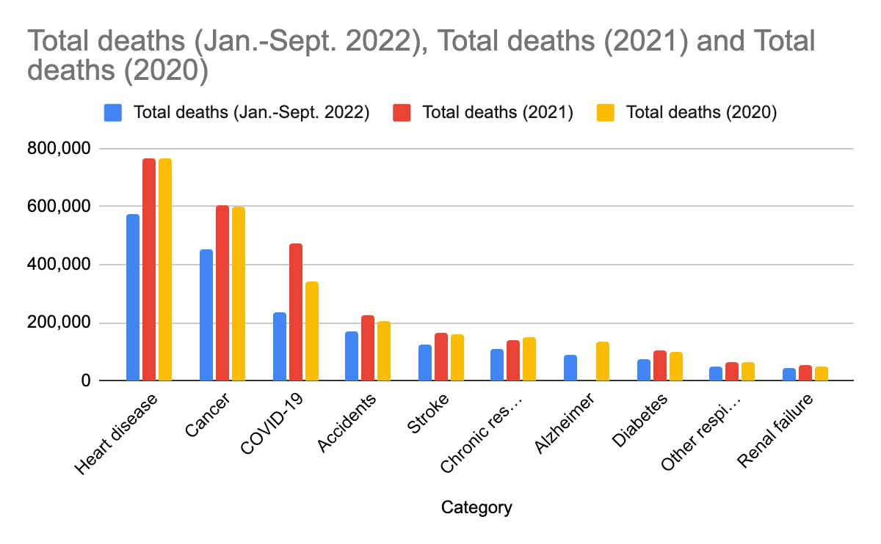
Source: Health System Tracker

Slide 3
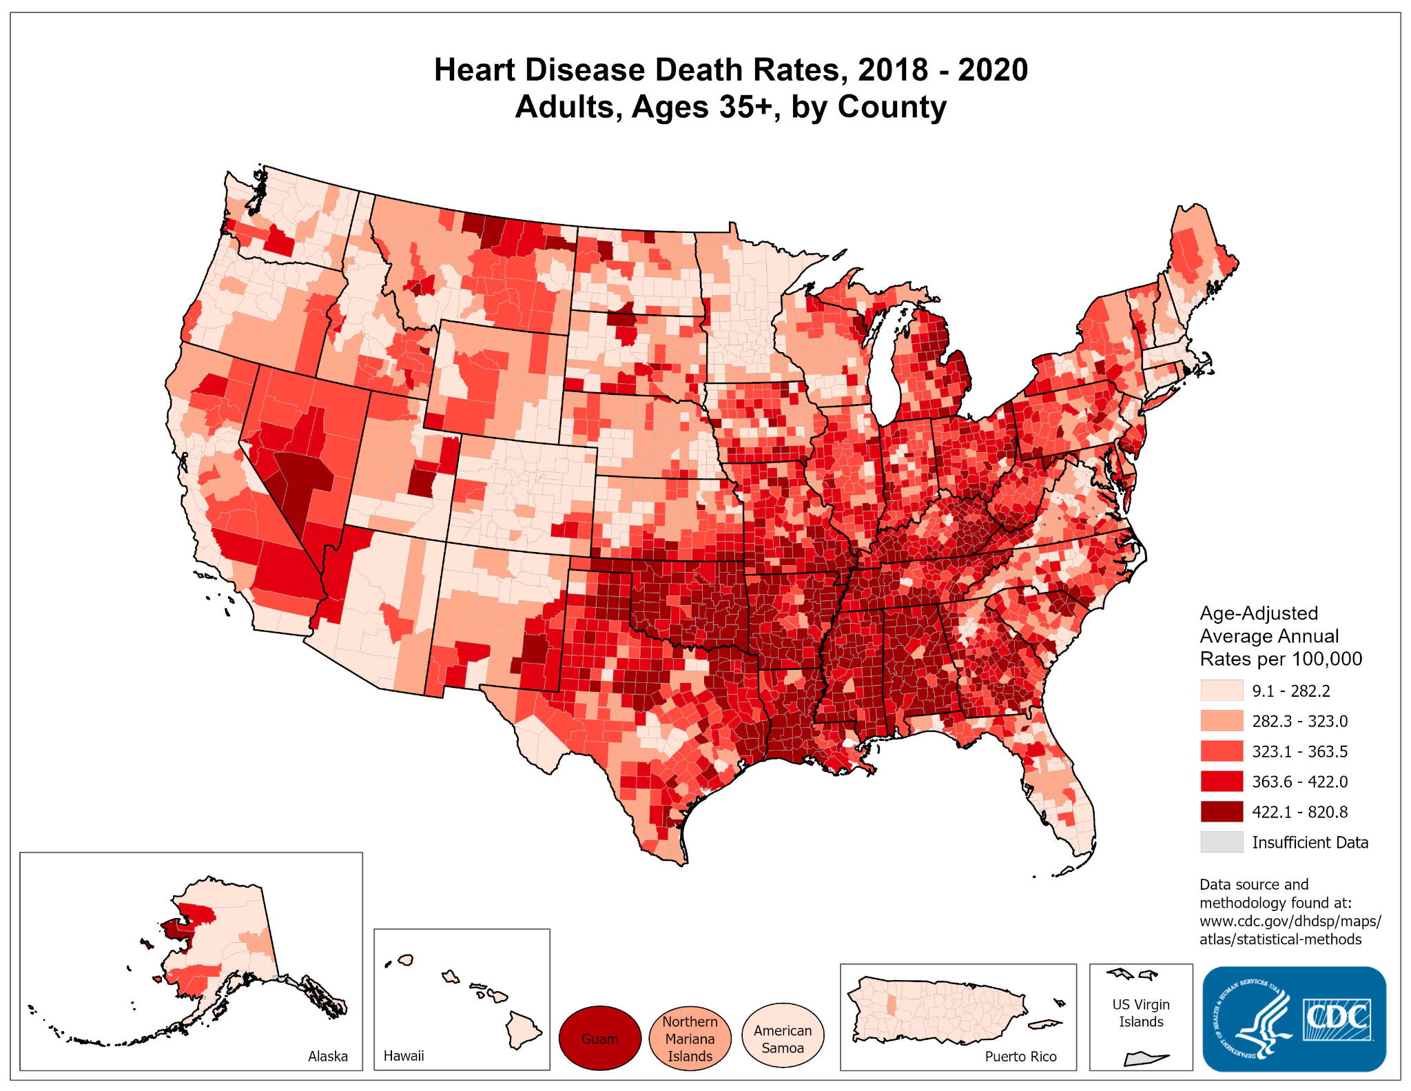
Source: Centres for Disease Control and Prevention

Slide 4

The problem
Accurately stratifying individuals at high risk of developing heart diseases, even when they don't exhibit obvious risk factors like high cholesterol or hypertension, remains a challenge.

Slide 5

The solution
We're employing three distinct approaches — Random Forest, Logistic Regression, and Neural Network — to construct an efficient predictive model. Our objective is to identify the most effective model among these by evaluating their performance based on accuracy

Slide 6
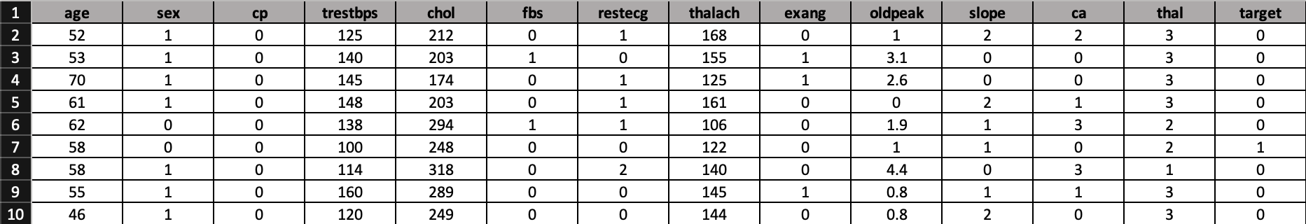
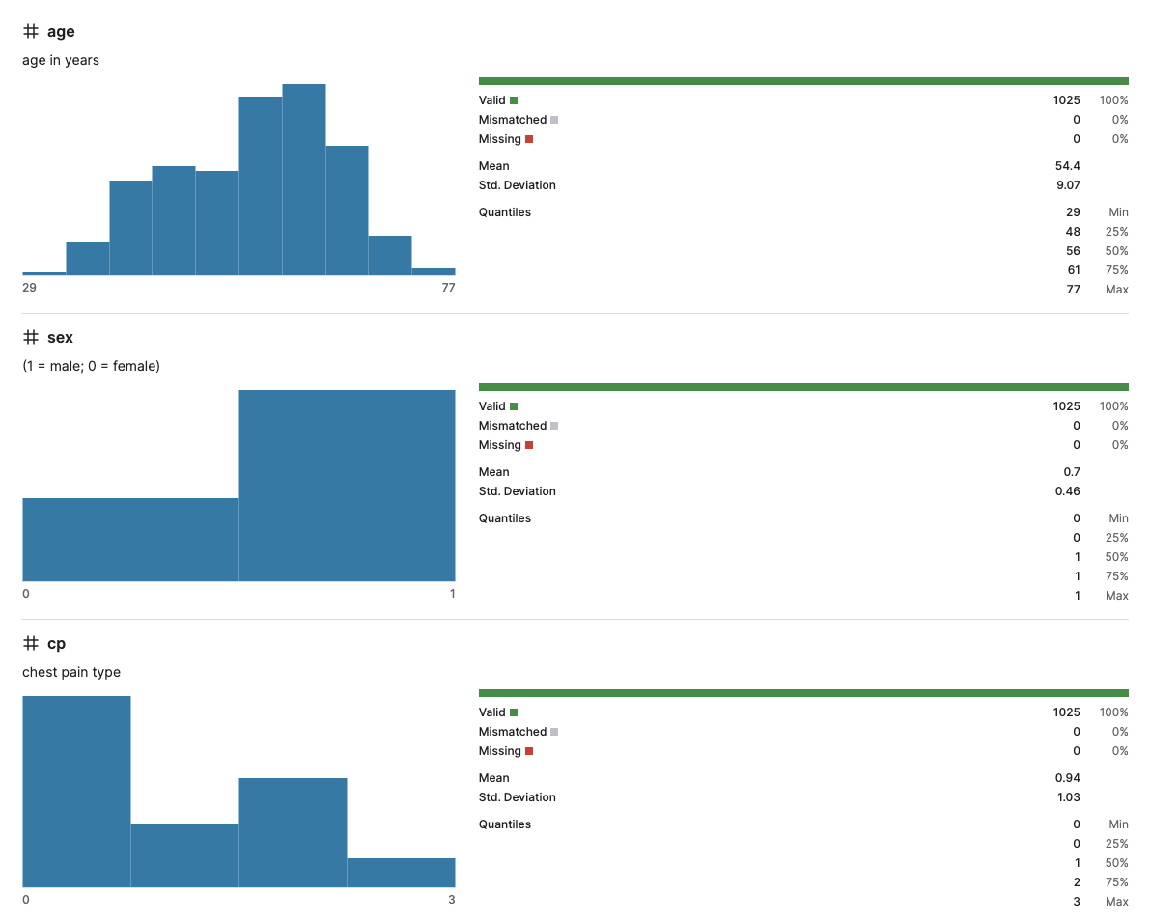
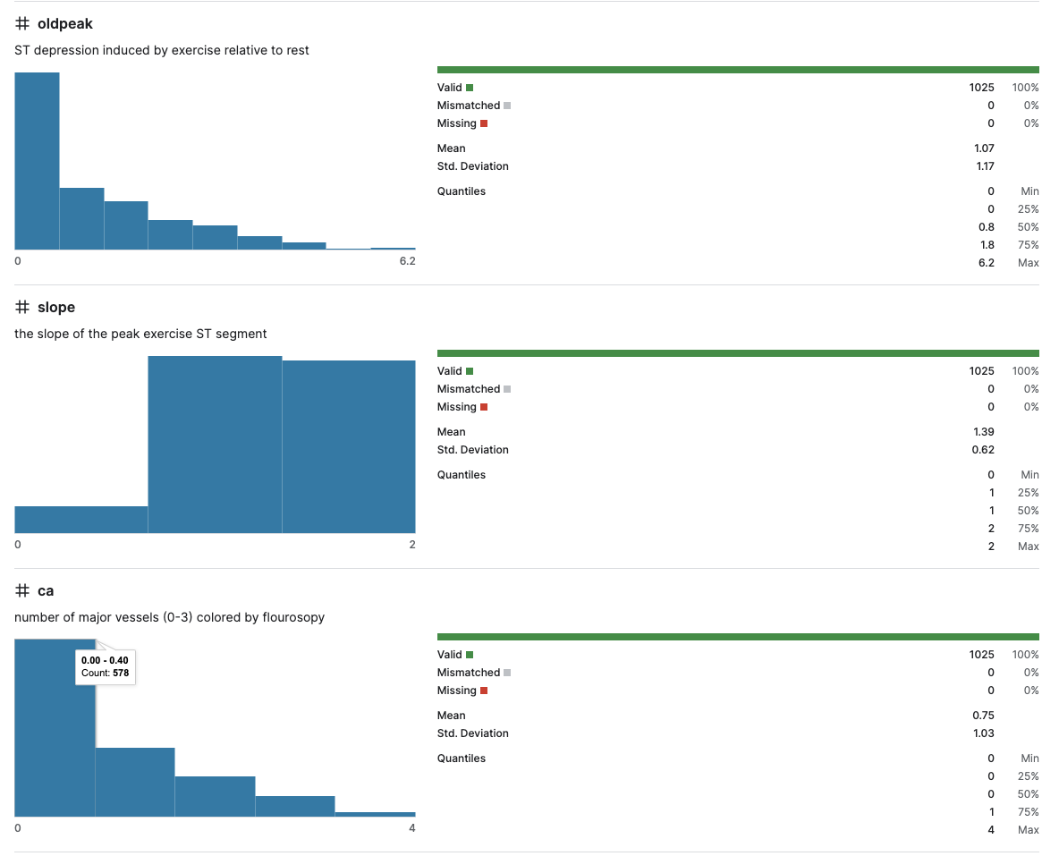
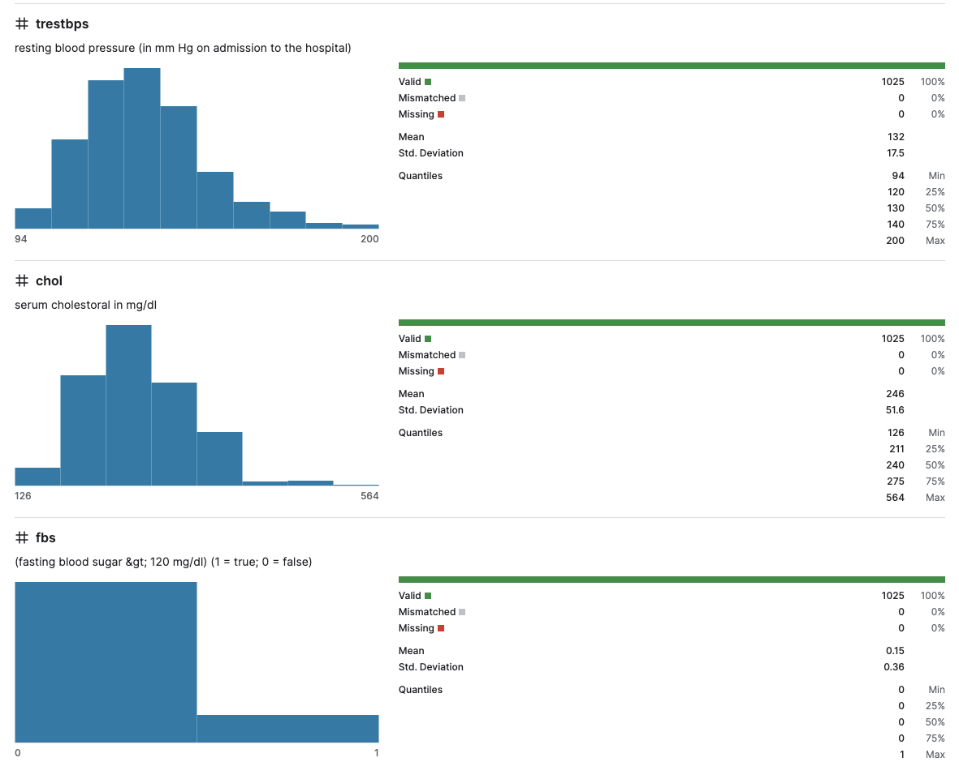
The Dataset
Dataset source: Kaggle

Slide 7
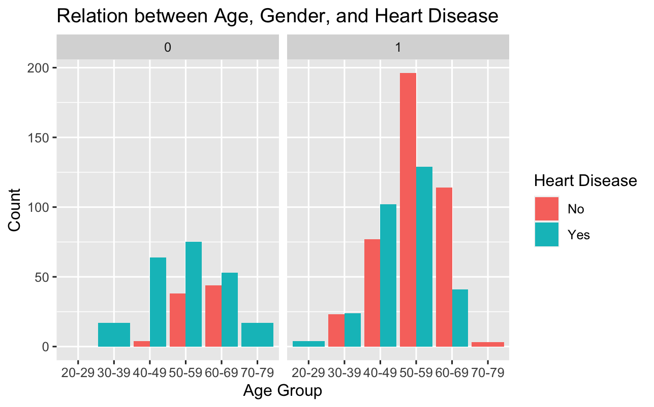
Influence of the probability of developing heart disease considering age and gender
It illustrates the count of individuals, categorized by age groups and gender, indicating the presence or absence of heart disease in each group
The data depicted in the graph illustrates that women aged between 40 and 70 exhibit a heightened susceptibility to experiencing heart attacks compared to men. Conversely, men within the age range of 40 to 60 display relatively lower probabilities of encountering a heart attack

Slide 8
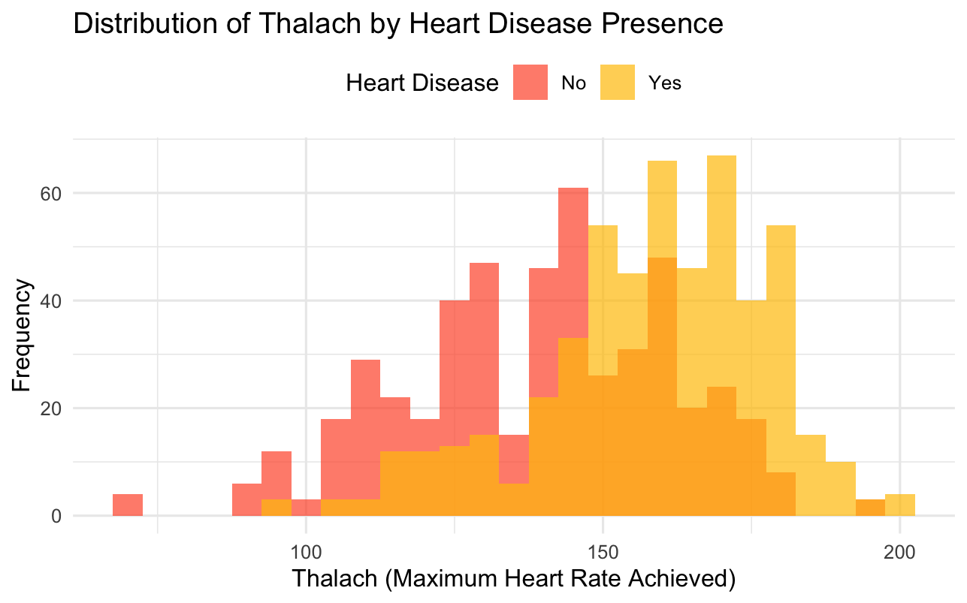
Comparison of Maximum Heart Rate (Thalach) between Individuals with and without Heart Disease
This histogram presents the distribution of maximum heart rate achieved during exercise (thalach) for individuals categorized with and without heart disease, accompanied by overlaid density plots for better visualization.
Interpretations: Observations indicate that individuals diagnosed with heart disease tend to achieve a maximum heart rate slightly below 200 beats per minute. Conversely, those without heart disease typically exhibit a maximum heart rate of approximately 150 beats per minute. This disparity suggests that the presence of heart disease correlates with an elevated pulse rate in affected individuals.

Slide 9

Random
Forest

Slide 10
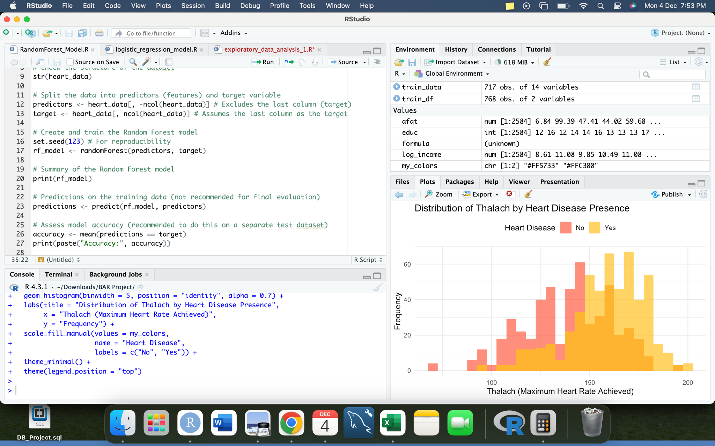
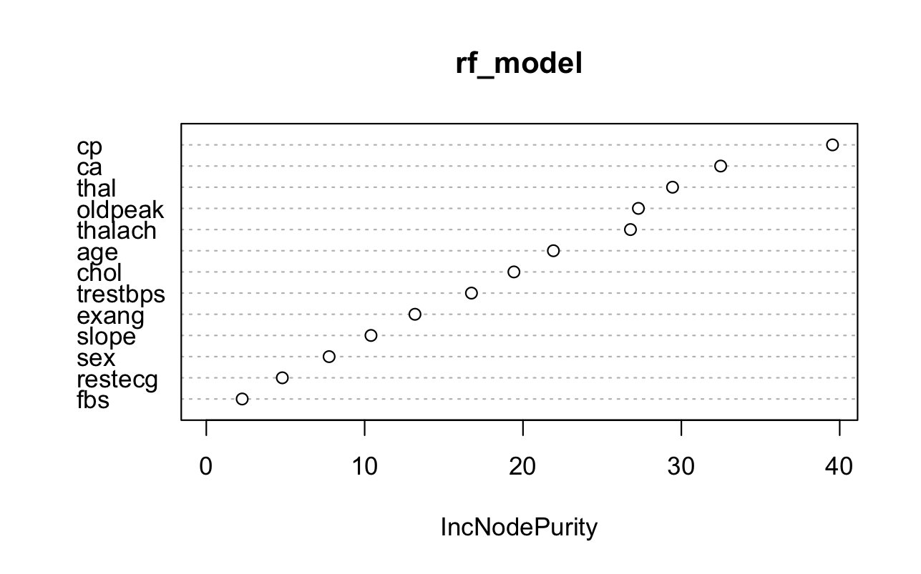
Random Forest
rf_model <- randomForest(predictors, target) builds a random forest model using the randomForest function. It takes the predictors and target variables as inputs to train the model. It's important to note that evaluating model accuracy on the training data (as done here) might not reflect how well the model generalizes to new, unseen data. It's typically better to assess model performance on a separate test dataset to avoid overfitting.

Slide 11

Neural
Network

Slide 12
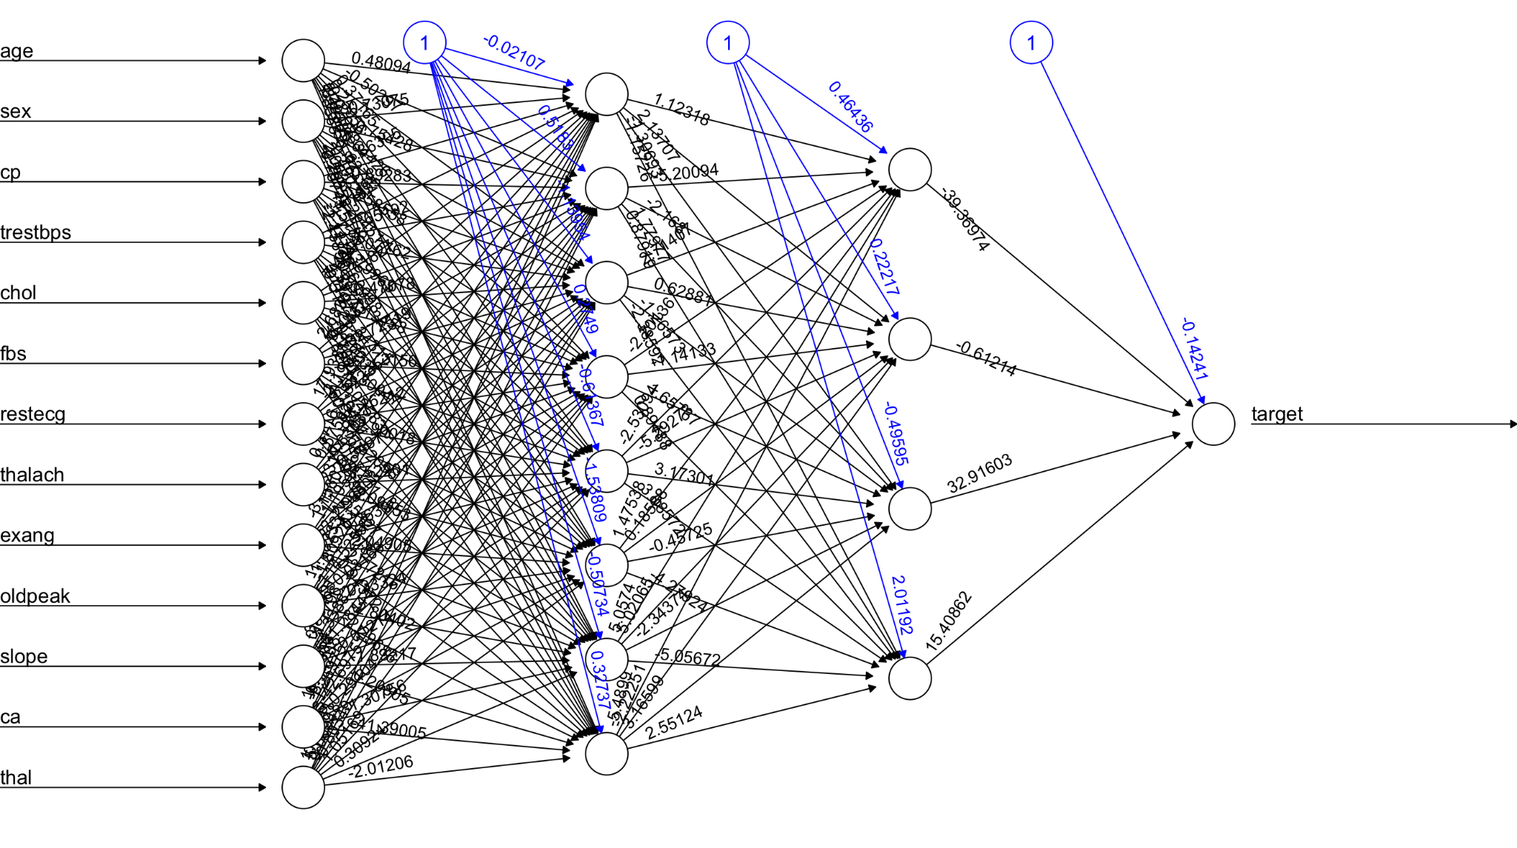
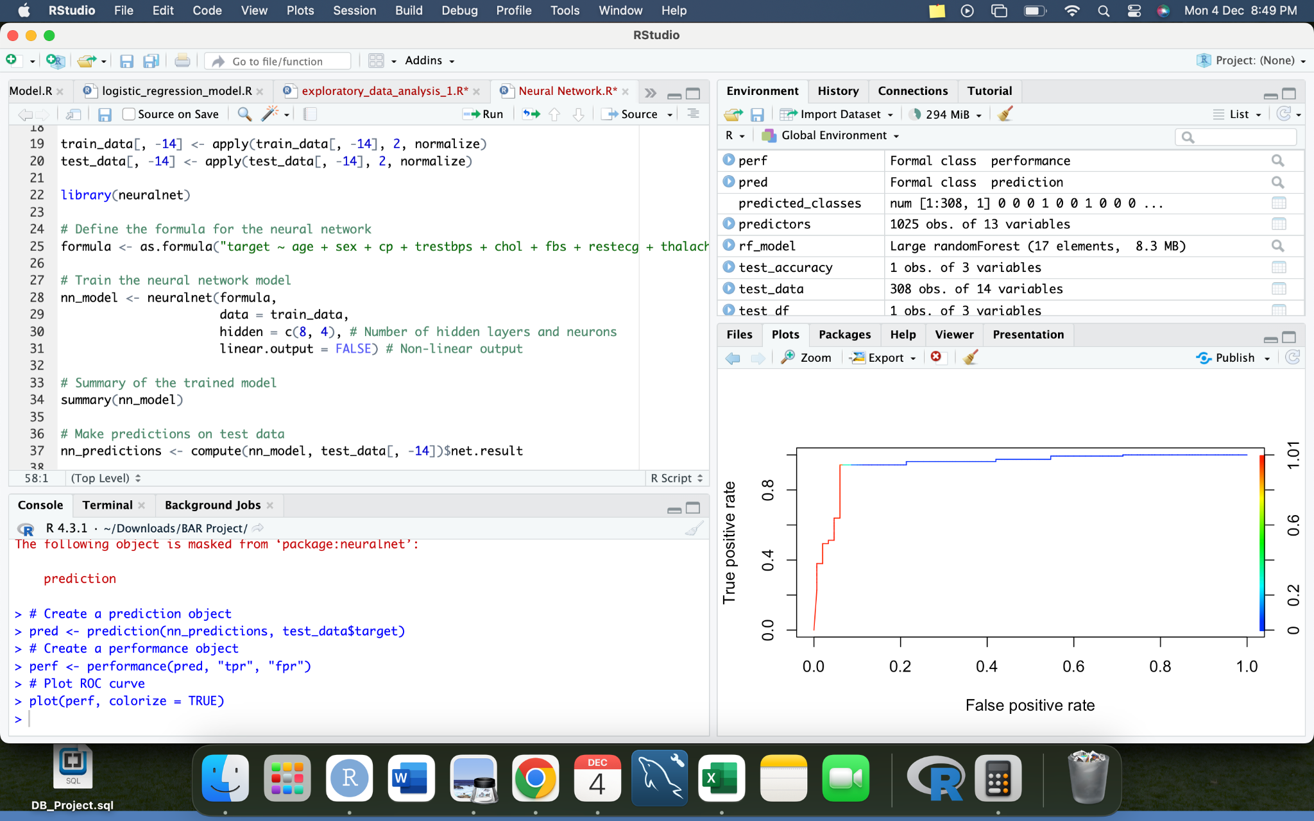
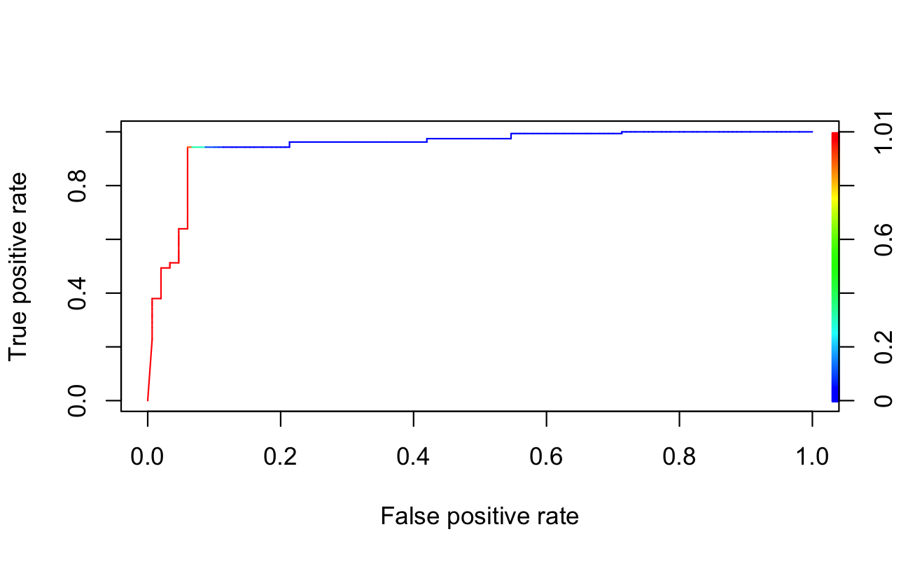
2. Neural Network
nn_model trains a neural network model using the neuralnet function, specifying the formula, the training data (train_data), and the architecture of the network (number of hidden layers and neurons per layer, here it's 8 neurons in the first hidden layer and 4 in the second).

Slide 13

Logistic
Regression

Slide 14
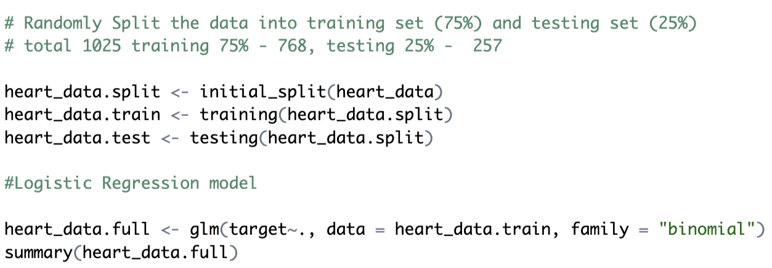
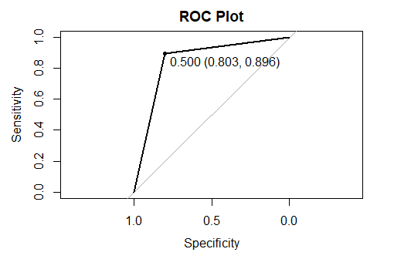
3. Logistic regression
glm function builds a logistic regression model using 9 predictor variables, 4 removed variables - age, chol, fbs, slope which were found to be insignificant predictors The model essentially splits the data into training and testing sets and then fits a logistic regression model to the training data.
The optimal threshold point using (thres = "best"), where sensitivity and specificity are maximized.

Slide 15
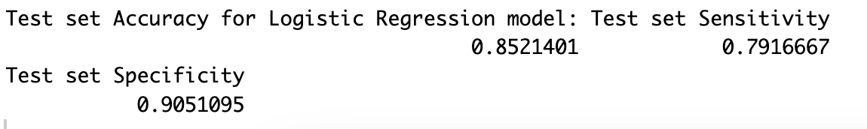
Accuracy of Logistic regression model
The model has a test set accuracy of 0.8521, which indicates 85% of the patients in the test set are correctly classified as having heart disease or not. The true positive rate on the test set is 79.16% and the true negative rate is 90.51%.

Slide 16
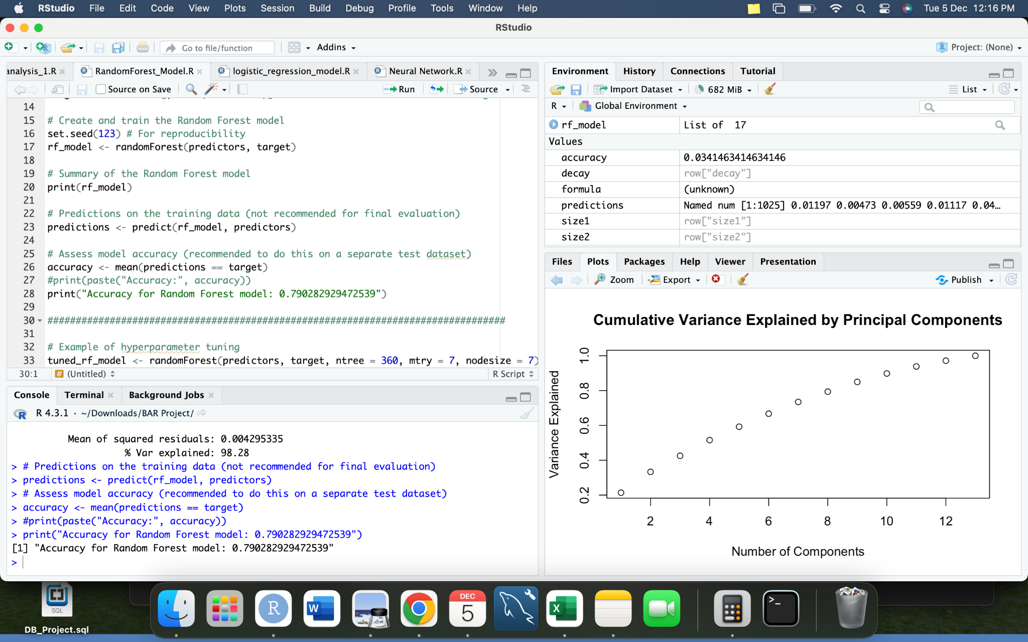

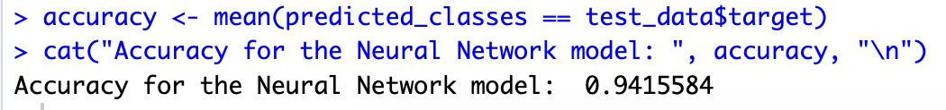
Accuracies of the models

Slide 17
Conclusion
From the table, we can see that Neural Network has achieved the highest accuracy of 94% on the dataset
The lowest accuracy we achieved was for Random Forest model, which is 79%
It can be concluded that the Neural Network algorithm has performed the best among all the algorithms in the given table, achieving an accuracy score of 94%. Therefore, it would be reasonable to select the Neural Network algorithm for the dataset.
Therefore we can conclude that we get a higher accuracy for Neural Networks for predicting heart diseases.

